Slide 1

Computational Methods in
Power System Analysis
Lecture-10 Solution of Simultaneous Algebraic Equations And Load Flow Studies
By
Dr. Wazir Muhammad Laghari
Electrical Engineering Department
BUET, Khuzdar

Slide 2
Methods to Solve Solution of Simultaneous Algebraic Equations
Direct Method Iterative Method
Elimination Decomposition
Jacobi’s
Method
Gauss-Seidel
Method
Relaxation
Method
Gaussian Elimination Method
Gauss-Jordan Method
Crout’s Reduction Method
Cholesky’s Reduction Method

Slide 3
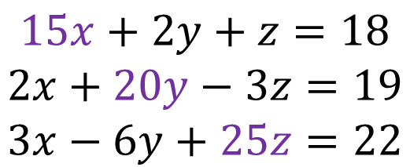
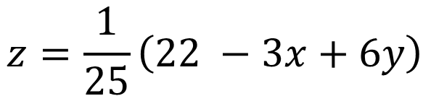
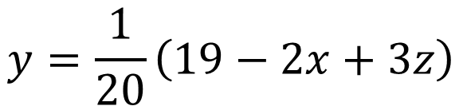
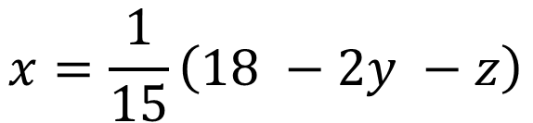
$$Q:Solve the Equations by Jacobi^{′}s Iteration Method$$
$$15x+2y+z=18$$
$$2x+20y−3z=19$$
$$3x−6y+25z=22$$
We observed in equations all diagonal values are greater than other variables in same row, than Jacobi’s applicable to solve system of linear equations
$$x=\frac{1}{15}\left(18 −2y −z\right)$$
$$y=\frac{1}{20}\left(19−2x+3z\right)$$
$$z=\frac{1}{25}\left(22 −3x+6y\right)$$

Slide 4
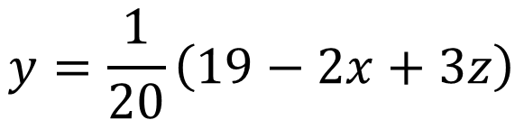
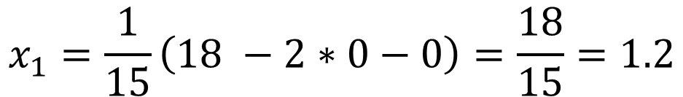
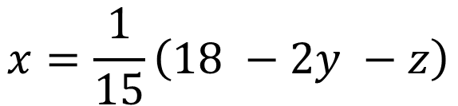

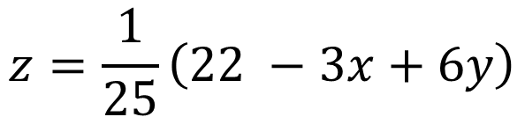
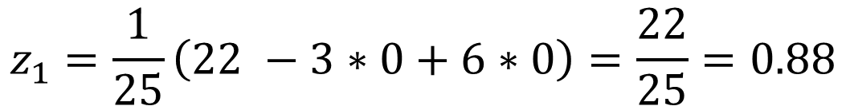
$$x=\frac{1}{15}\left(18 −2y −z\right)$$
$$y=\frac{1}{20}\left(19−2x+3z\right)$$
$$z=\frac{1}{25}\left(22 −3x+6y\right)$$
$$First Iteration$$
$$Put x=0, y=0 and z=0 OR x_{0}=0,y_{0}=0 and{ z}_{0}=0$$
$$x_{1}=\frac{1}{15}\left(18 −2∗0−0\right)=\frac{18}{15}=1.2$$
$y_{1}=\frac{1}{20}\left(19−2∗0+3∗0\right)=\frac{19}{20}=0.95$
$$z_{1}=\frac{1}{25}\left(22 −3∗0+6∗0\right)=\frac{22}{25}=0.88$$

Slide 5
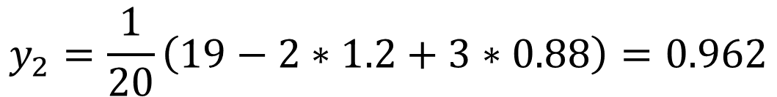
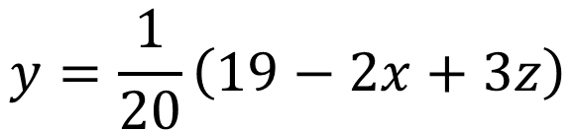
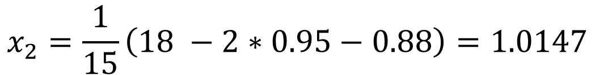
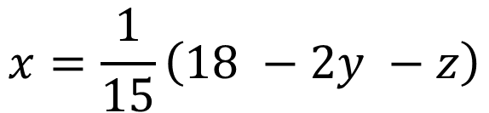

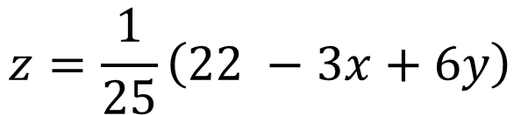
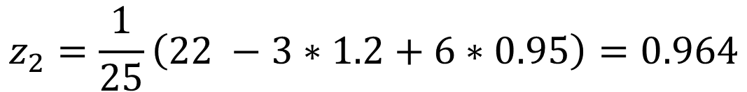
$$Second Iteration$$
$$x=\frac{1}{15}\left(18 −2y −z\right)$$
$$Put x_{1}=1.2,y_{1}=0.95 and z_{1}=0.88$$
$$y=\frac{1}{20}\left(19−2x+3z\right)$$
$$x_{2}=\frac{1}{15}\left(18 −2∗0.95−0.88\right)=1.0147$$
$$z=\frac{1}{25}\left(22 −3x+6y\right)$$
$$y_{2}=\frac{1}{20}\left(19−2∗1.2+3∗0.88\right)=0.962$$
$$z_{2}=\frac{1}{25}\left(22 −3∗1.2+6∗0.95\right)=0.964$$

Slide 6
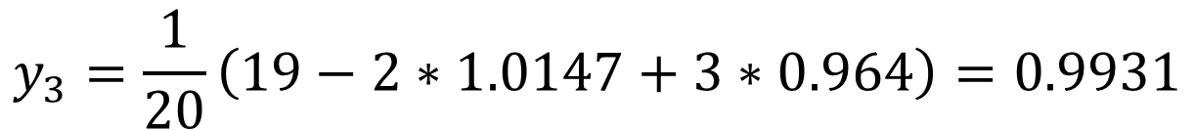
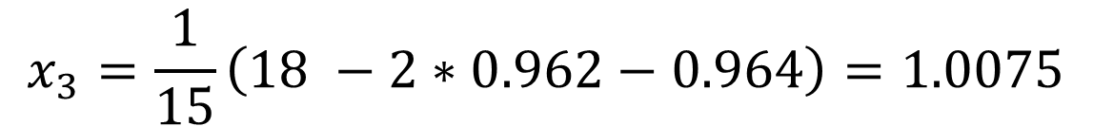

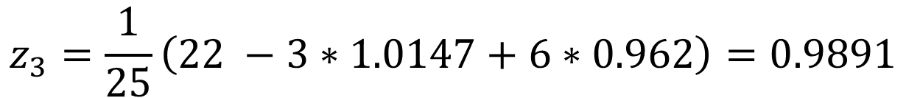
$$Third Iteration$$
$$x=\frac{1}{15}\left(18 −2y −z\right)$$
$$Put x_{2}=1.0147,y_{2}=0.962 and z_{2}=0.964$$
$$y=\frac{1}{20}\left(19−2x+3z\right)$$
$$x_{3}=\frac{1}{15}\left(18 −2∗0.962−0.964\right)=1.0075$$
$$z=\frac{1}{25}\left(22 −3x+6y\right)$$
$$y_{3}=\frac{1}{20}\left(19−2∗1.0147+3∗0.964\right)=0.9931$$
$$z_{3}=\frac{1}{25}\left(22 −3∗1.0147+6∗0.962\right)=0.9891$$

Slide 7
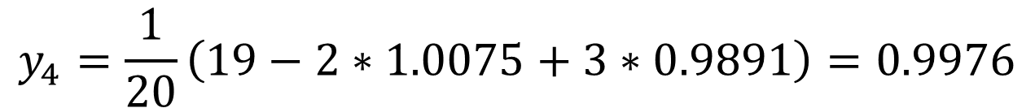
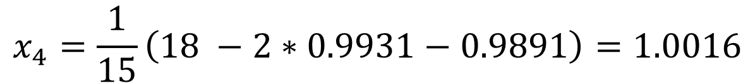

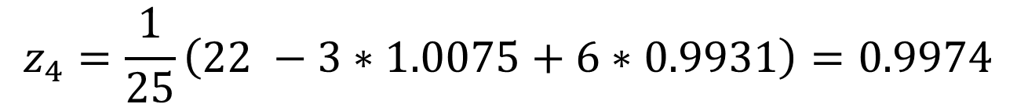
$$Fourth Iteration$$
$$x=\frac{1}{15}\left(18 −2y −z\right)$$
$$Put x_{3}=1.0075,y_{3}=0.9931 and z_{3}=0.9891$$
$$y=\frac{1}{20}\left(19−2x+3z\right)$$
$$x_{4}=\frac{1}{15}\left(18 −2∗0.9931−0.9891\right)=1.0016$$
$$z=\frac{1}{25}\left(22 −3x+6y\right)$$
$$y_{4}=\frac{1}{20}\left(19−2∗1.0075+3∗0.9891\right)=0.9976$$
$$z_{4}=\frac{1}{25}\left(22 −3∗1.0075+6∗0.9931\right)=0.9974$$

Slide 8
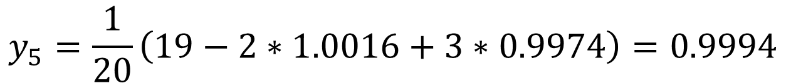
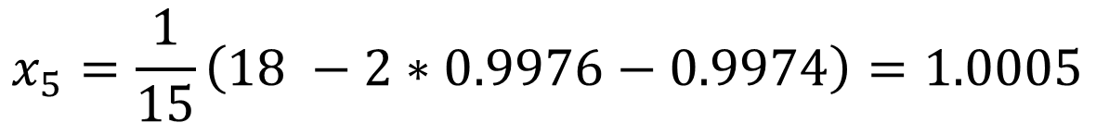

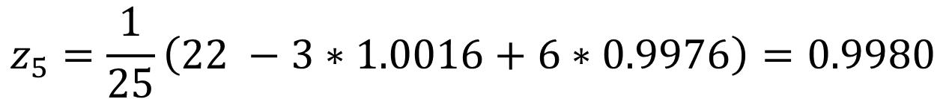
$$Fifth Iteration$$
$$x=\frac{1}{15}\left(18 −2y −z\right)$$
$$Put x_{4}=1.0016,y_{4}=0.9976 and z_{4}=0.9974$$
$$y=\frac{1}{20}\left(19−2x+3z\right)$$
$$x_{5}=\frac{1}{15}\left(18 −2∗0.9976−0.9974\right)=1.0005$$
$$z=\frac{1}{25}\left(22 −3x+6y\right)$$
$$y_{5}=\frac{1}{20}\left(19−2∗1.0016+3∗0.9974\right)=0.9994$$
$$z_{5}=\frac{1}{25}\left(22 −3∗1.0016+6∗0.9976\right)=0.9980$$

Slide 9
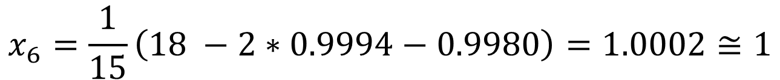


$$Sixth Iteration$$
$$x=\frac{1}{15}\left(18 −2y −z\right)$$
$$Put x_{5}=1.0005,y_{5}=0.9994 and z_{5}=0.9980$$
$$y=\frac{1}{20}\left(19−2x+3z\right)$$
$$x_{6}=\frac{1}{15}\left(18 −2∗0.9994−0.9980\right)=1.0002≅1$$
$$z=\frac{1}{25}\left(22 −3x+6y\right)$$
$$y_{6}=\frac{1}{20}\left(19−2∗1.0005+3∗0.9980\right)=0.9996≅1$$
$$z_{6}=\frac{1}{25}\left(22 −3∗1.0005+6∗0.9994\right)=0.9998≅1$$
$$Therefore, may be next iterations its values are equal to 1$$
$$x=y=z =1$$

Slide 10


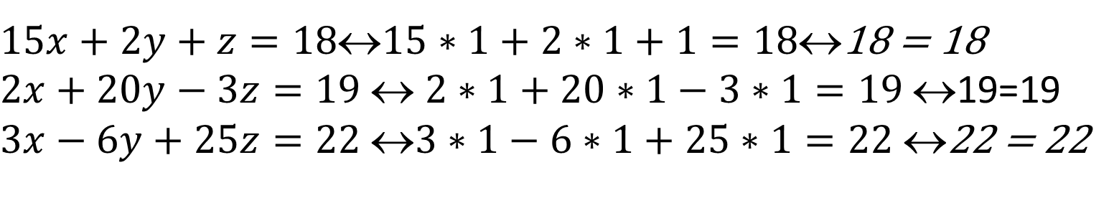
$$CHECKING$$
$$Put x=y=z =1$$
$15x+2y+z=1815∗1+2∗1+1=18$18 = 18
$2x+20y−3z=19$ $$ $2∗1+20∗1−3∗1=19$ $$19=19
$3x−6y+25z=22$ $3∗1−6∗1+25∗1=22$ $$22 = 22

